Slide 1
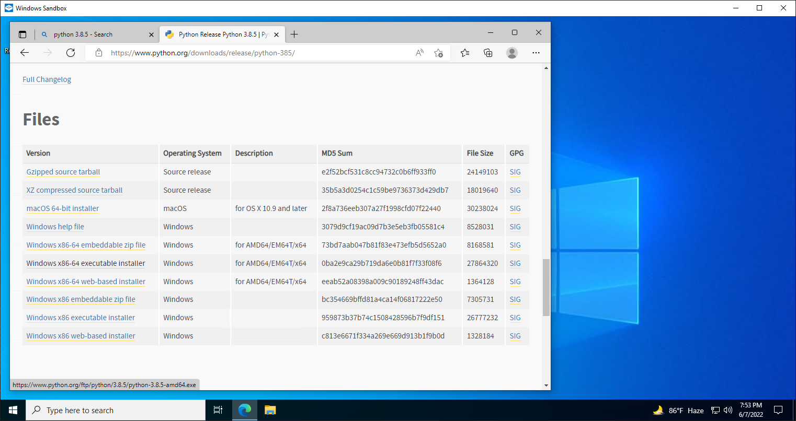
Installing Python 3.8.5 From the link below
https://www.python.org/ftp/python/3.8.5/python-3.8.5-amd64.exe

Slide 2
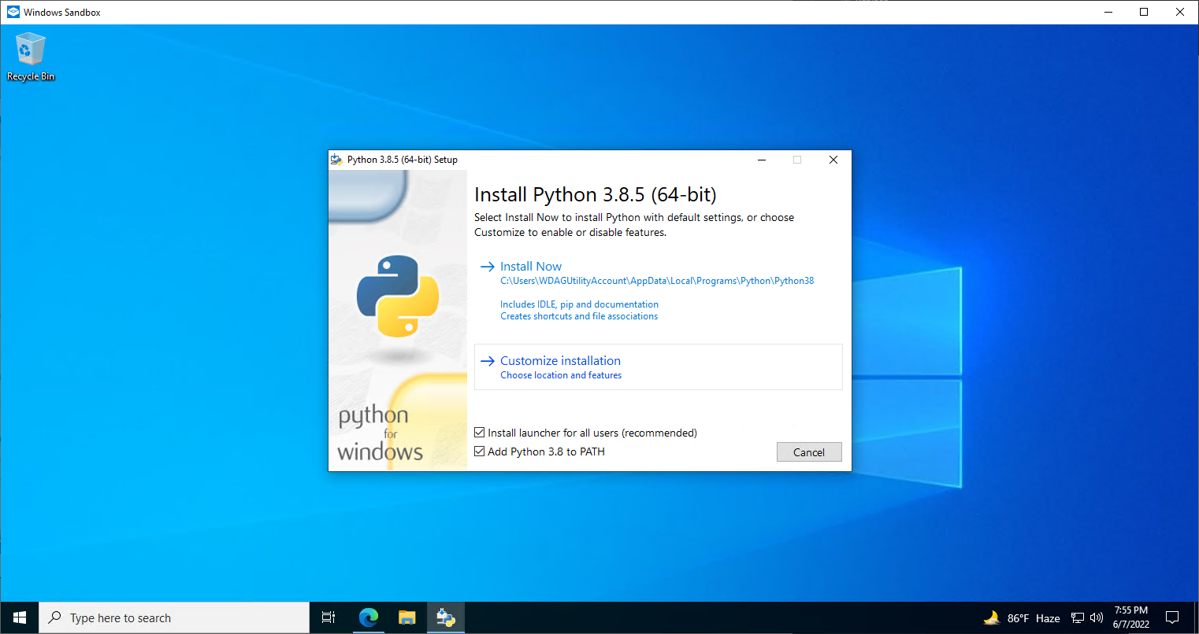
Tick mark the red squared box
Then select “Customize installation”

Slide 3
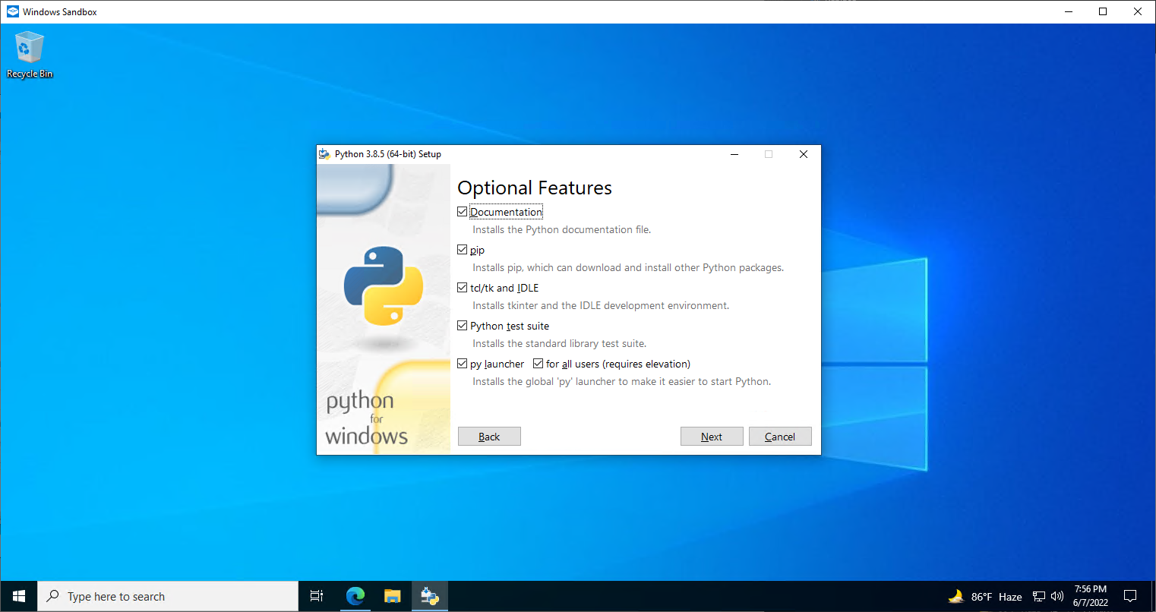
Tick mark all the boxes

Slide 4
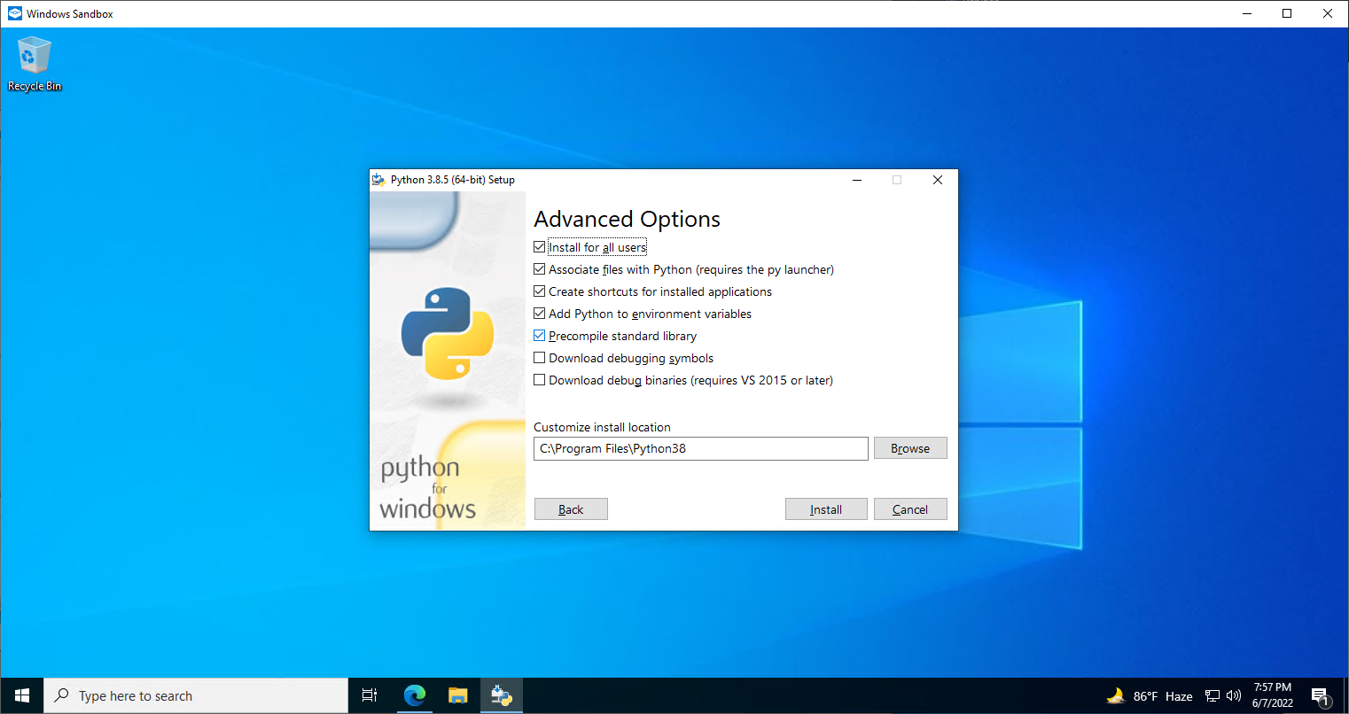
MUST Tick mark the red squared box along with the following ones
Then make sure the install location is like below

Slide 5
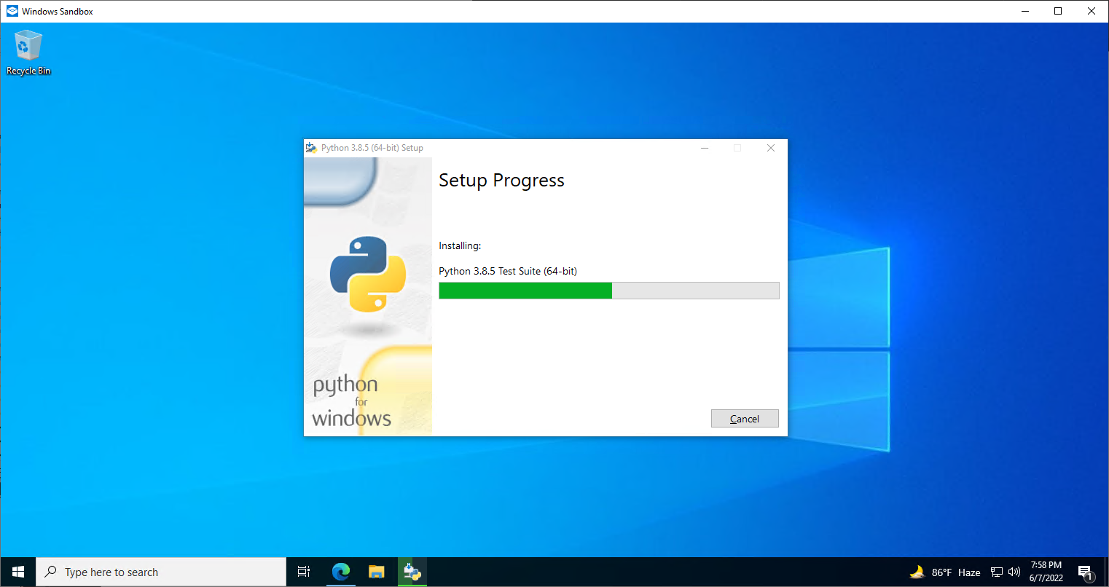
If there is no error the installation will start like this

Slide 6
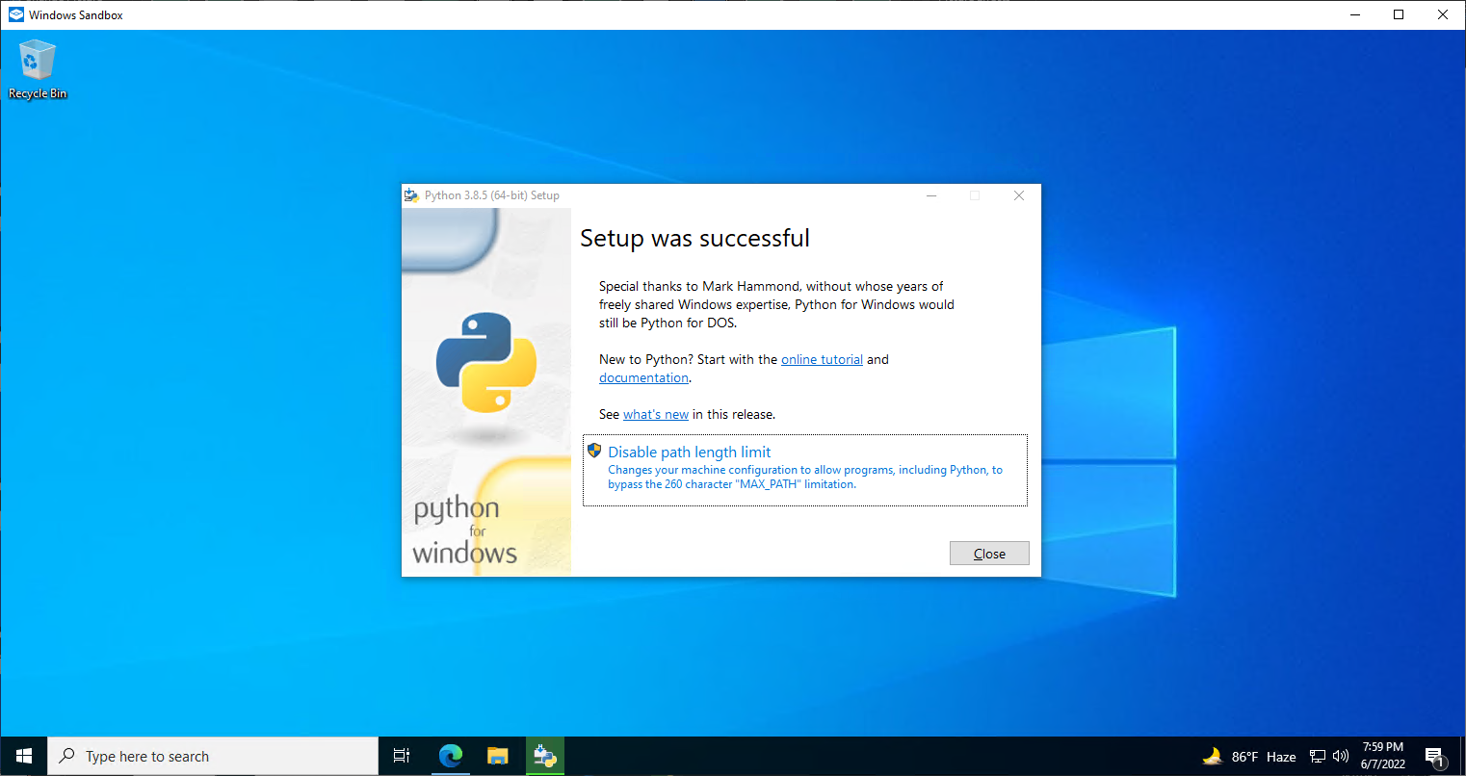
After the installation finishes select the marked box and disable it

Slide 7
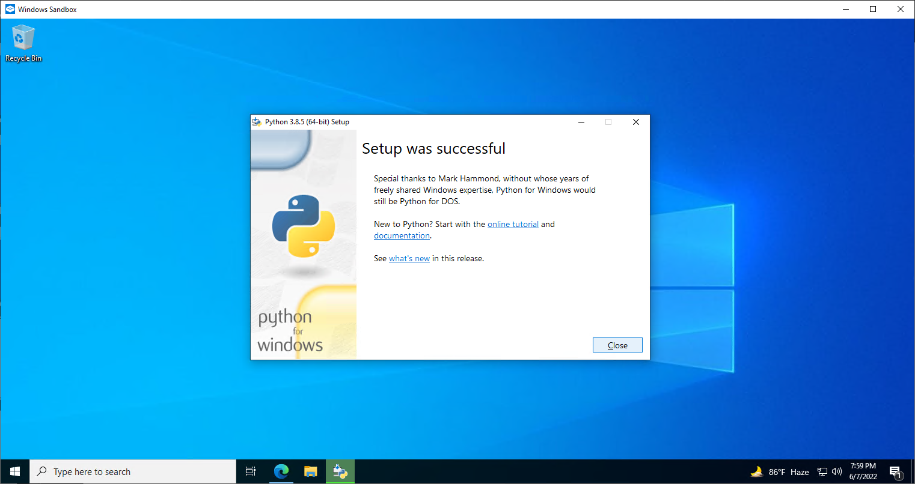
A successful installation will look like this

Slide 8
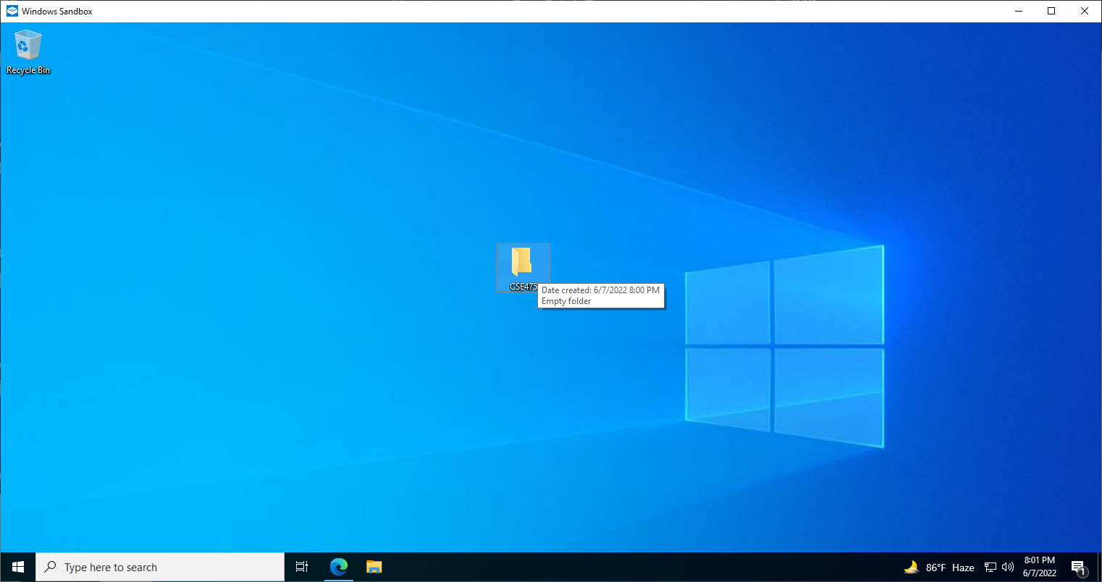
After this create a folder in your desired location and name it properly

Slide 9
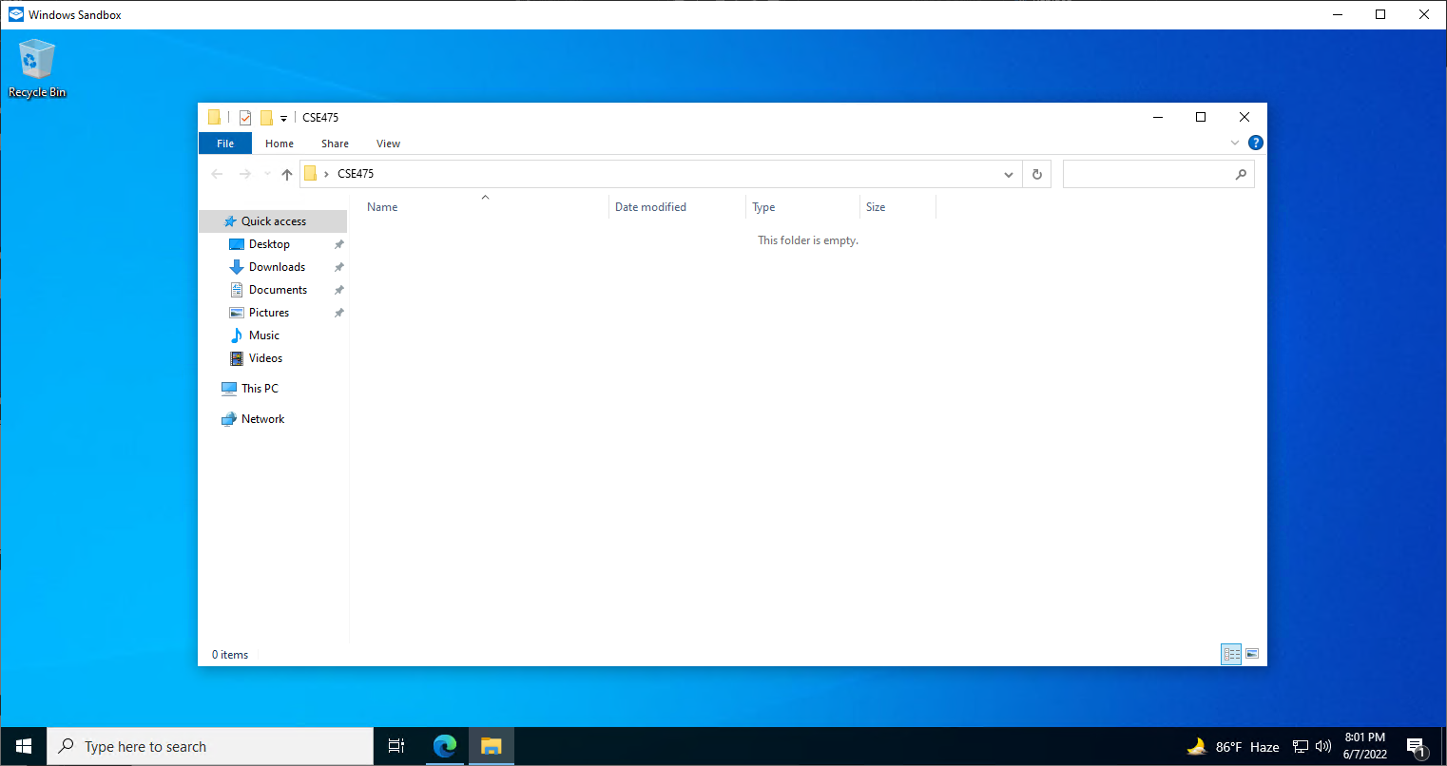
After opening it click the path box marked by red color

Slide 10
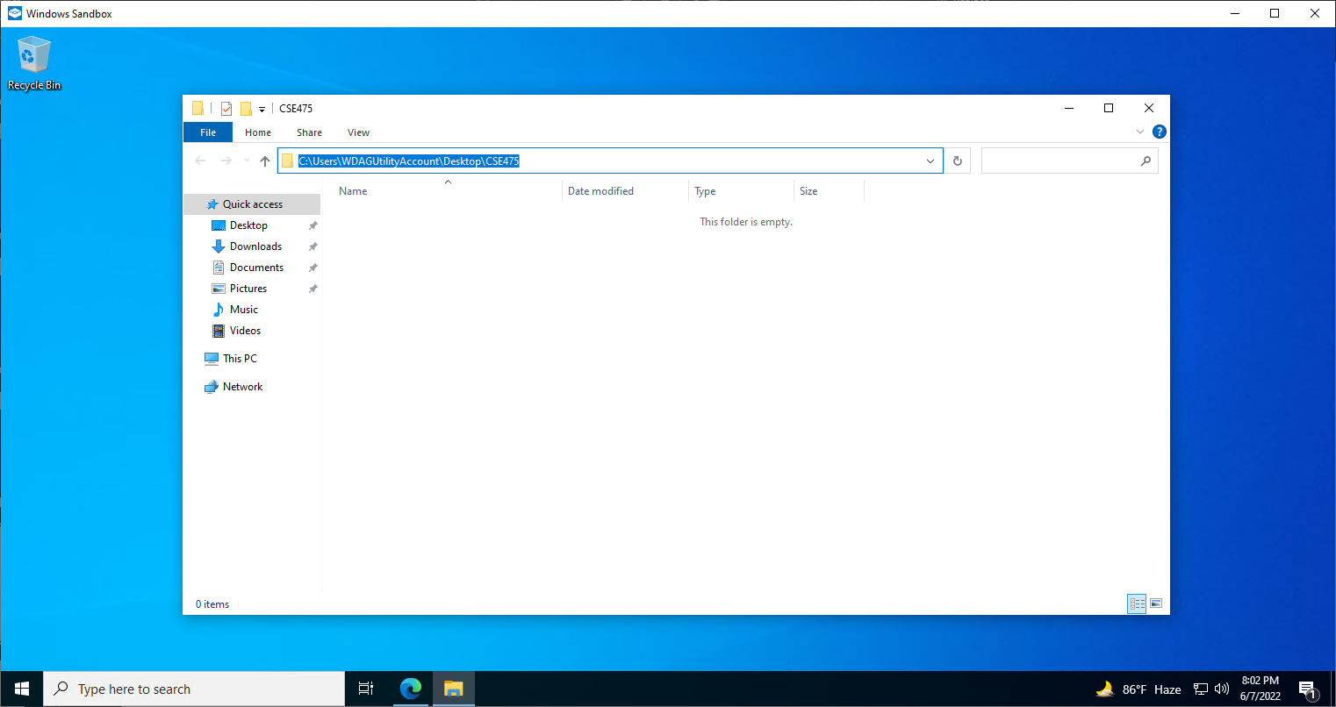
It will get selected like this

Slide 11

Remove it and type cmd like the picture and then press enter to start the command prompt under that location

Slide 12
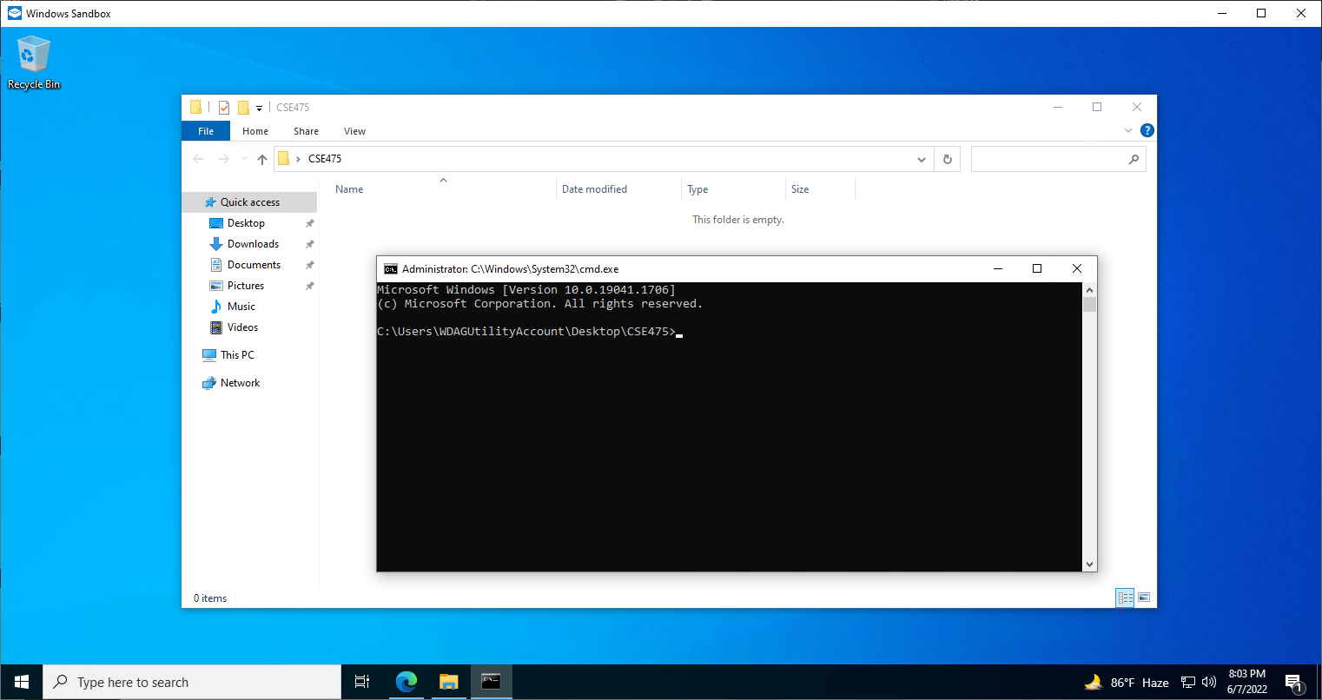
Then the command prompt will open up like this

Slide 13

Type in the command
pip install notebook

Slide 14
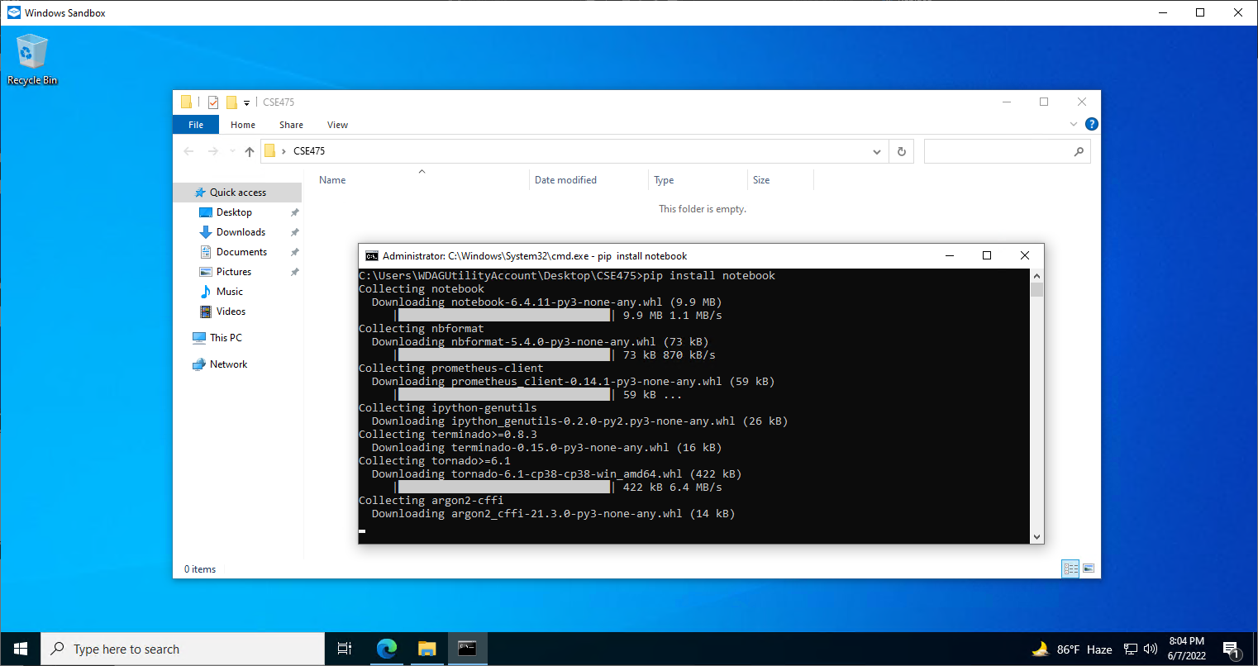
If the command was successfully executed, the download process would start like this

Slide 15
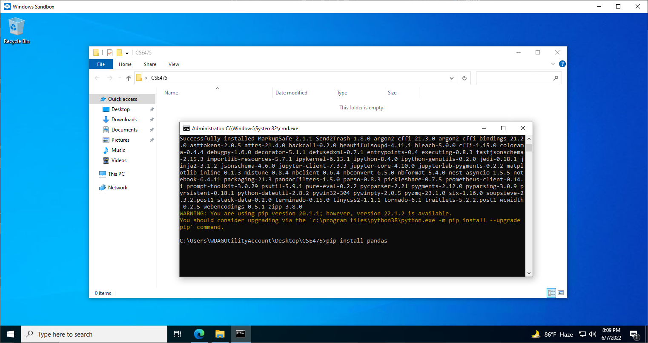
After the installation, finishes type in the next command and press enter
pip install pandas

Slide 16

If the command was successfully executed, the download process would start like this

Slide 17
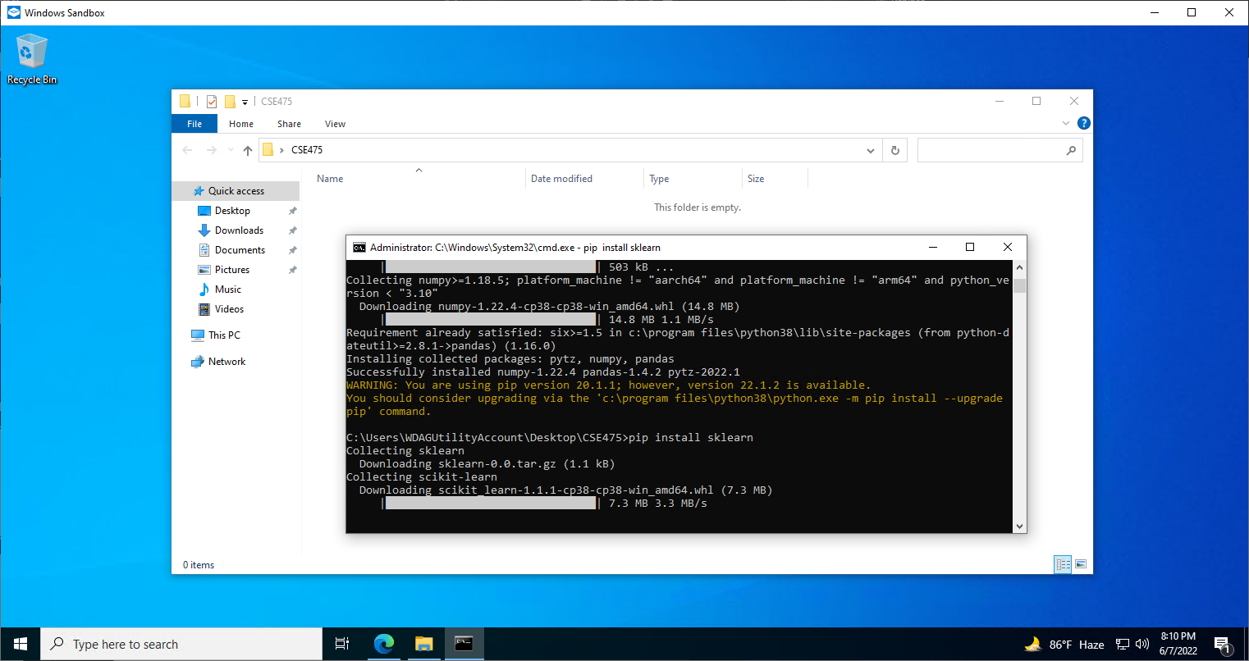
After the installation, finishes type in the next command and press enter
pip install sklearn

Slide 18
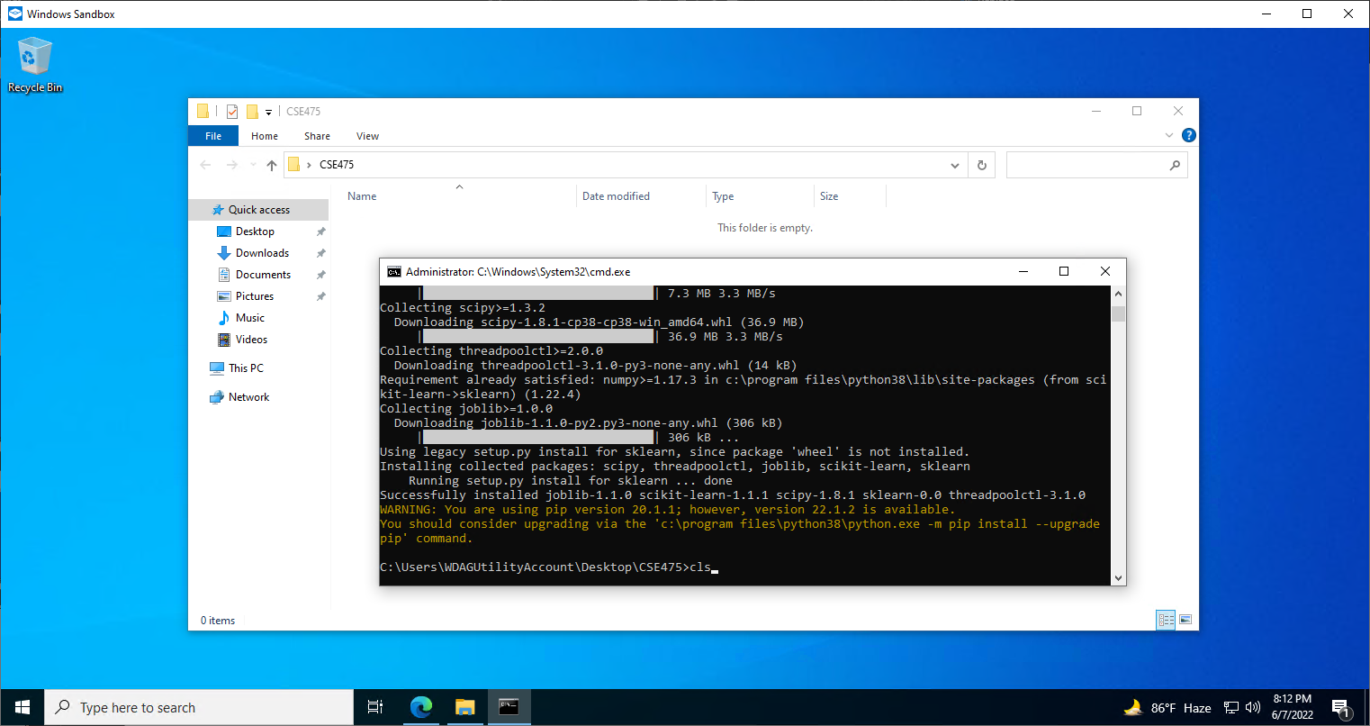
After the installation, finishes type in the next command and press enter
cls
this command clears the window to make it look cleaner

Slide 19
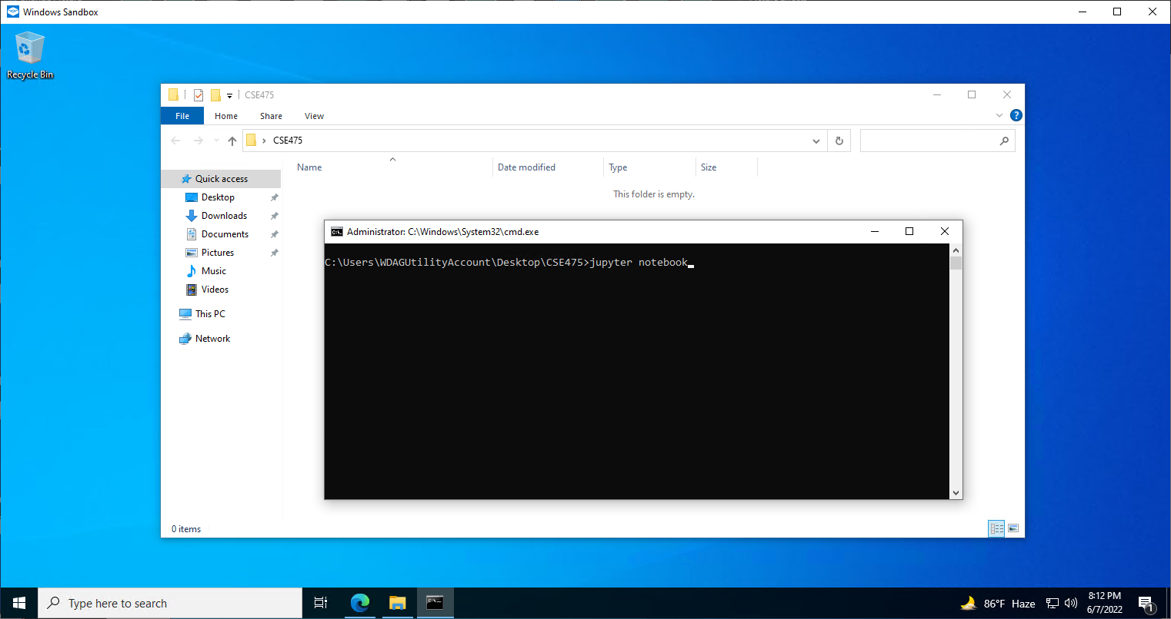
After the window clears, type in the next command and press enter
jupyter notebook

Slide 20

A successful command will start a notebook server to write code
The cmd window will look like this

Slide 21
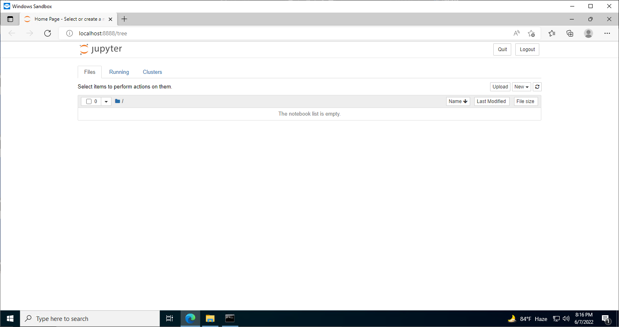
After the command a browser will open up with the following page with url
localhost:8888/tree

Slide 22
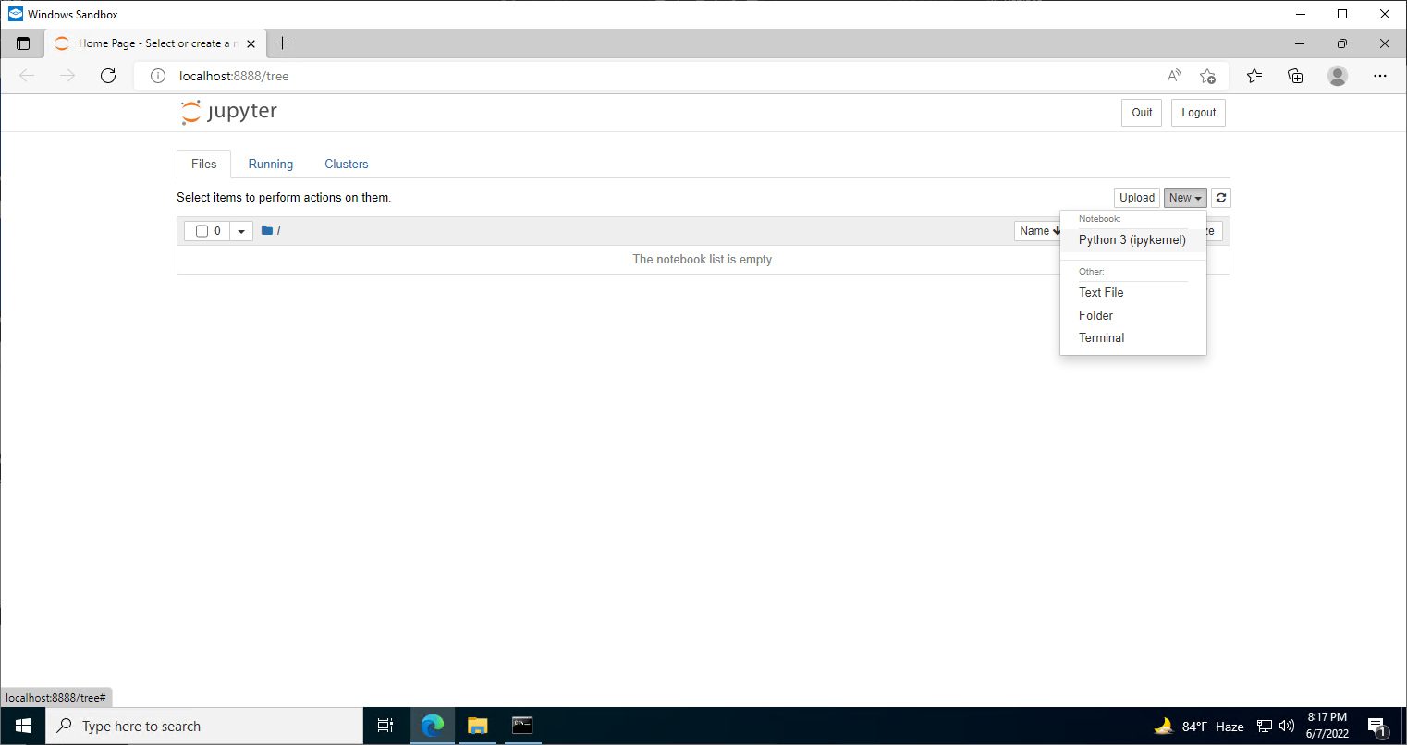
Press New and then select the Python 3 (ipykernel) interpreter marked in the box

Slide 23
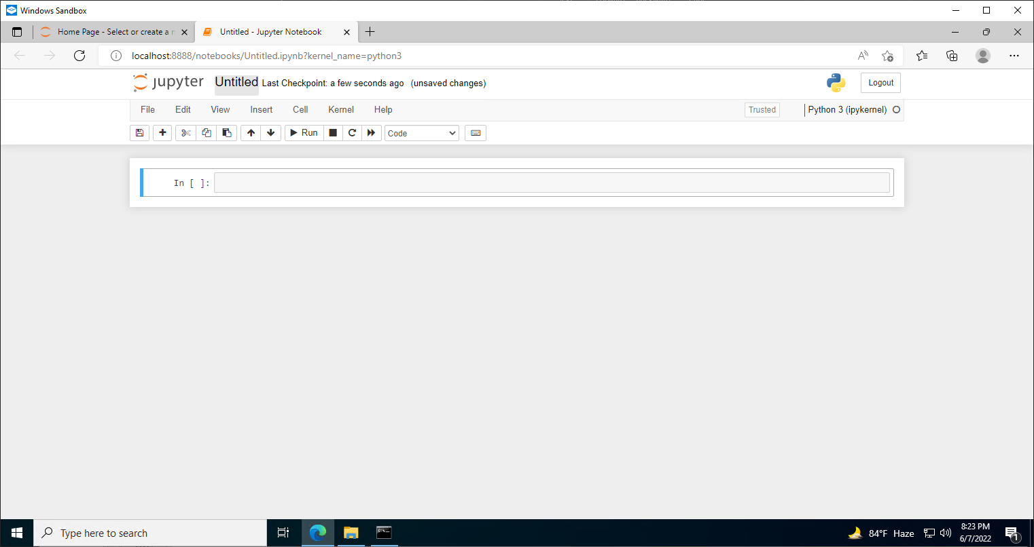
After the selection, a new window will open, then select the marked box and rename the file

Slide 24
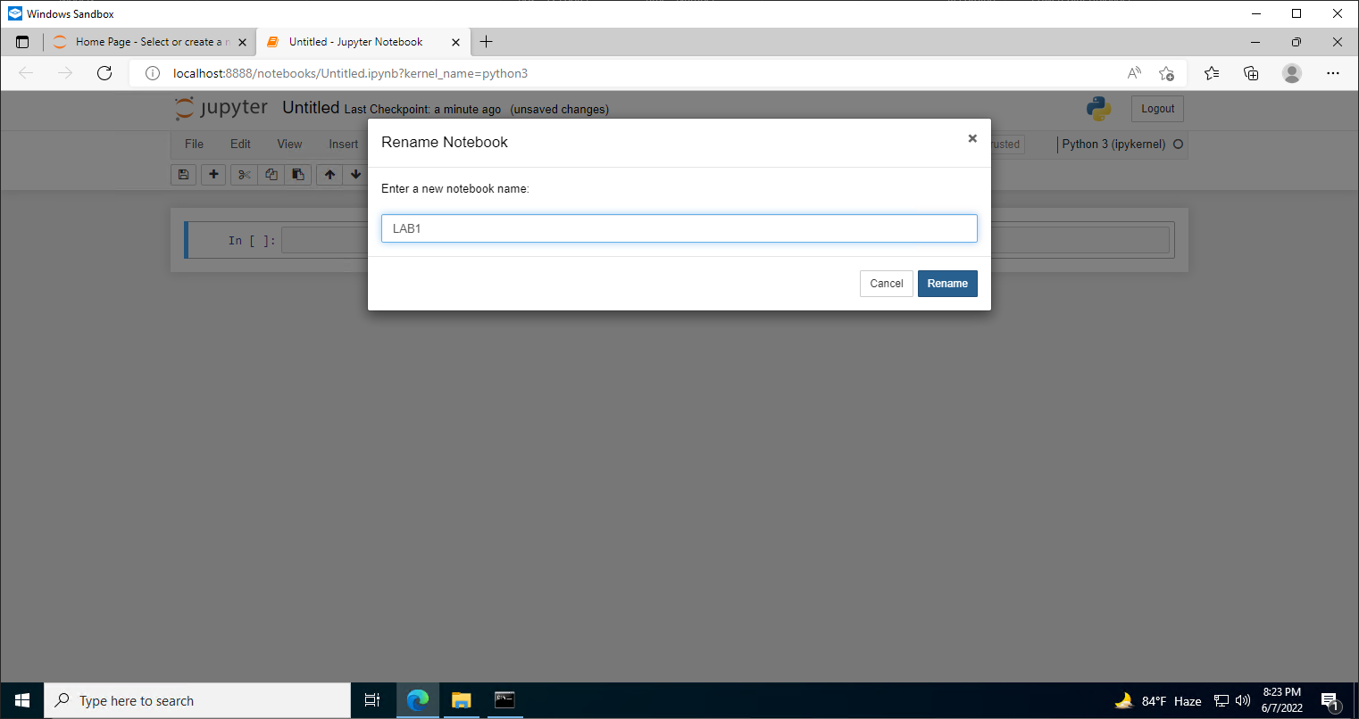

Slide 25
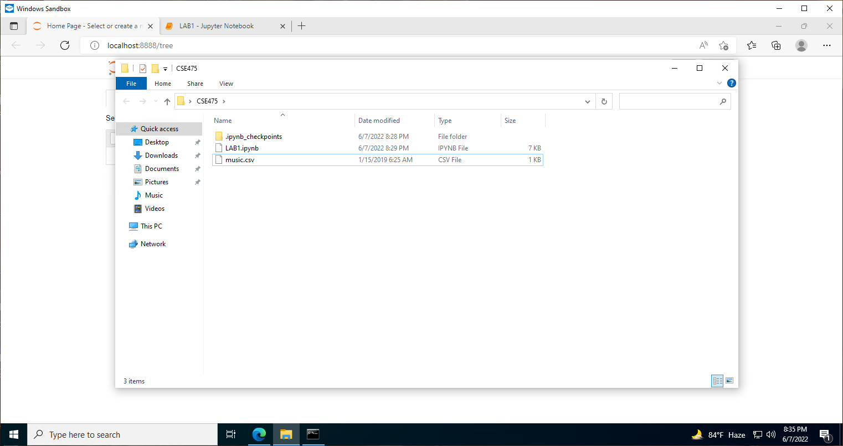
Then go back to the folder where we started our cmd, you will see a new file named LAB1.ipynb
this is the file where our codes and output will be saved.
Then copy the music.csv file in this location and proceed further

Slide 26
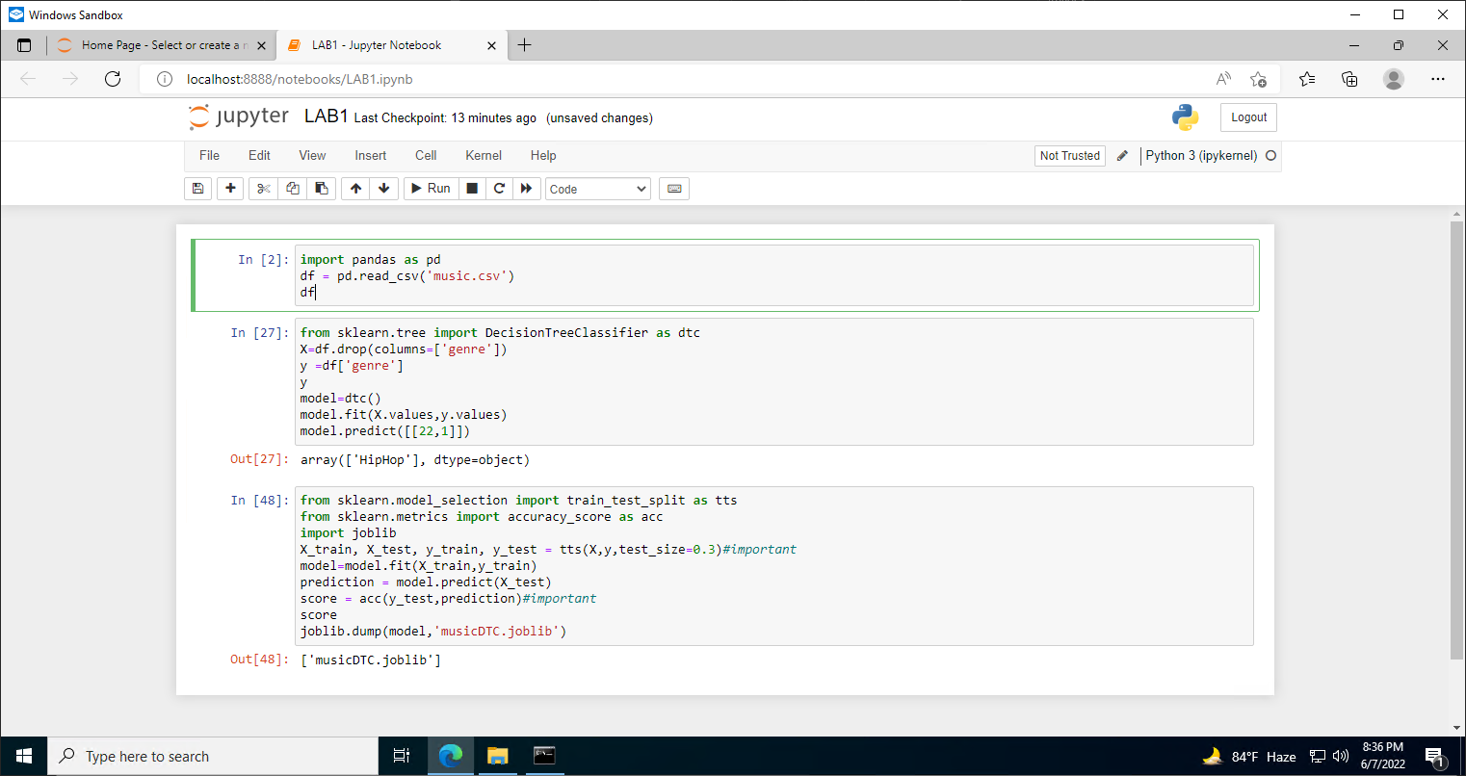
Follow the following codes to get the desired result discussed in
LAB1

